Slide 1
Problem Statement
How could the resort optimize the capitalization of facilities in order to cover the extra $1.54 million cost on adding extra chairs by the end of this season?
Solution: optimize the ticket price through a data-driven strategy and implement this strategy to cover the extra $1.54 million cost by the end of this season.
Key data: the CSV file contains all peer resorts and features.
Data science: train a model to predict the ticket price based on data its competitors.

Slide 2
Recommendation and key findings
1.The modeling suggest the ticket price can increase to $95.87 from current $81.
2. Option: Adding a run, increasing the vertical drop by 150 feet, and installing an additional chair lift.
Table 1. The Recommendations
Options | ticket price change ($) | Total amount over the season*
Adding a run, increasing the vertical drop by 150 feet, and installing an additional chair lift. | increase 1.99 | $3.47M
Adding a run, increasing the vertical drop by 150 feet, installing an additional chair lift, and adding 2 acres of snow making | increase 1.99 | $3.47M
* On the assumption of total visitors over the season is 350,000 and each visitor ski for five days.

Slide 3
Modeling results and analysis-1
Two models: linear regression and random forest.
metrics to evaluate model performance:
-R²
-mean absolute error MAE
- mean squared error MSE
predictor: mean and median of ticket price
missing value impute: either mean or median
A set features instead of all features used in modeling: avoid overfit

Slide 4
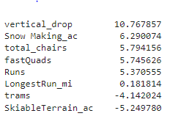
Modeling results and analysis-2
Linear regression model
The biggest positive features associated with ticket price: vertical_drop, Snow Making_ac,total_chairs, fastQuads and Runs.
trams and SkiableTerrain_ac are the negative features.
MAE: 11.79
Coefficients Rank

Slide 5
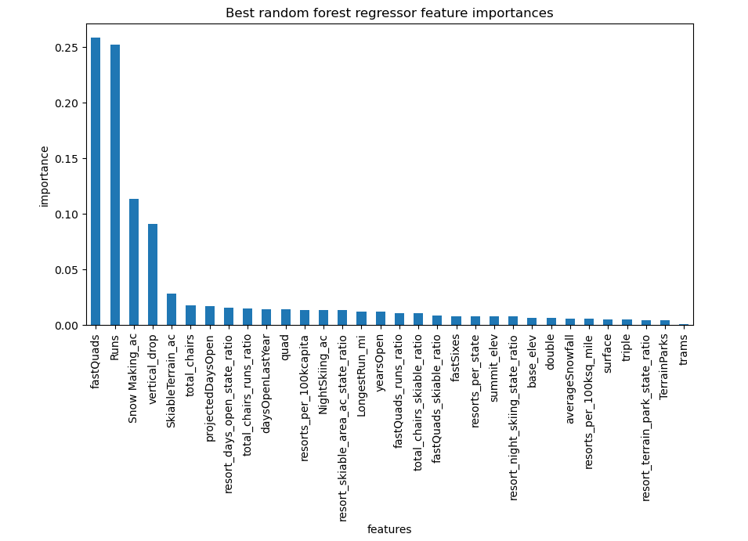
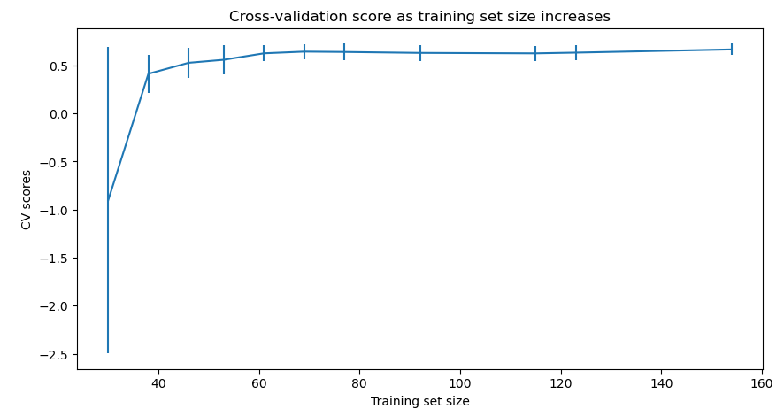
Modeling results and analysis-3
Random forest model (The winner model)
MAE: 9.54
Data quality assessment: no need further data collection

Slide 6
Summary and conclusion
To optimze ticket price based on the peer resorts, the provdie ski_data was cleaning and explored, two ticket price models were evaluate.
The random forest model was the winner model and it suggest the ticket price can increased to $95.87 from current $81.
Among the four busnines scenarios modeling, the best candiate is Adding a run, increasing the vertical drop by 150 feet, and installing an additional chair lift.
the extract cost of $1.54M can be covered at the end of the season by increasing ticket price by only $1.99 under the best business option.

